Slide 1
人工智能
主讲人：张晓丹
信息科学与技术学院
Email: xiaodanzhang@nwu.edu.cn

Slide 2
10 MACHINE LEARNING: SYMBOL-BASED
10.0 Introduction
Section 10.1 outlines a variety of learning tasks.
Section 10.2 and 10.3 examine two algorithms used for concept induction ,version space search and ID3.
Section 10.4 considers the role of inductive bias in learning.
The section before 10.6 are supervised learning.
Section 10.6 continues the study of induction by examining unsupervised learning.
In 10.7,we present reinforcement learning.

Slide 3
10.1 A Framework for Symbol-Based Learning
Representation language
Concept space
Operations
Heuristic search
Acquired knowledge
Figure 10.1 A general model of the learning process
Data and goals of the learning task

Slide 4
1.The data and goals of the learning task.one of the primary ways in which we characterize learning problems is according to the goals of the learner and the data it is given.
The concept learning algorithms of section 10.2 and 10.3,begin with a collection of positive examples of a target class,the goal is to infer a general definition that will allow the learner to recognize future instances of the class.Explanation-based learning(Section 10.5),attempts to infer a general concept from a single training example and a prior base of domain-specific knowledge.
These algorithms begin with a set of unclassfied indtances in section 10.6.

Slide 5
2.The represention of learned knowledge
For examples ,two instances of a ball may be represented by:
Size(obj1,small) ∧color(obj1,red) ∧shape(obj1,round)
Size(obj2,large) ∧color(obj1,red) ∧shape(obj1,round)
The general concept of ball could be defined by:
Size(X,Y) ∧color(X,Z) ∧shape(X,round)

Slide 6
3.A set of operations.
Size(obj1,small) ∧color(obj1,red) ∧shape(obj1,round)
Replacing a single constant with a variable products the generalizations.
Size(obj1,X) ∧color(obj1,red) ∧shape(obj1,round)
Size(obj1,small) ∧color(obj1,x) ∧shape(obj1,round)
Size(obj1,small) ∧color(obj1,red) ∧shape(obj1,x)
Size(x,small) ∧color(x,red) ∧shape(x,round)
4.The concept space.The representation language,together with the operations described above,defines a space of potential concept definitions.
语言和操作定义了潜在的概念空间。学习器必须搜索这个概念空间来寻找所期望的概念。

Slide 7
5.Heuristic search.
Size(obj1,small) ∧color(obj1,red) ∧shape(obj1,round)
Size(obj2,large) ∧color(obj2,red) ∧shape(obj2,round)
Size(X,Y) ∧color(X,red) ∧shape(shape,round)
Patrick Winston’s program learns general defininitions of structral concepts ,such as “arch”, in a blocks world.The training data is a series of positive and negative examples of the concept:examples of blocks world structures that fit in the category,along with near misses.

Slide 8
Arch
Arch
Near miss
Near miss
Figure 10.2 Examples and near misses for the concept arch
概念“拱门”的实例和小差别的实例

Slide 9
part
brick
supports
arch
part
brick
supports
part
brick
part
brick
supports
arch
part
brick
supports
part
pyramid
Figure 10.3 Generalization of descriptions to include multiple examples

Slide 10
polygon
isa
isa
brick
pyramid
part
brick
supports
arch
part
brick
supports
part
polygon
Figure 10.3 Generalization of descriptions to include multiple examples

Slide 11
part
brick
supports
arch
part
brick
supports
part
polygon
part
brick
supports
touch
touch
arch
part
brick
supports
part
polygon
Figure 10.4 Specialization of a description to exclude a near miss.In 10.4c we add constrints to 10.4a so that it can’t match with 10.4b
part
brick
supports
must-not-touch
must-not-touch
arch
part
brick
supports
part
polygon

Slide 12
10.2 Version Space Search
把概念学习解释为对空间的搜索。
Version space search illustrates the implementation of inductive learning as search through a concept space.Version space search takes advantage of the fact that generalization operations impose an ordering on the concepts in a space,and then uses this ordering to guide the search.
泛化操作对空间中的概念进行排序，然后用这个顺序指导搜索。

Slide 13
10.2.1 Generalization Operators and the Concept Space
Generalization and specialization are the most common types of operations for defining a concept space.The primary generalization operations used in machine learning are:
1.Replacing constants with variables.For example,
Color(ball,red) generalizes to color(X,red)
2.Dropping conditions from a conjunctive expression.
shape(X,round) ∧size(X,small) ∧color(X,red)
generalizes to shape(X,round) ∧ color(X,red)

Slide 14
3.Adding a disjunct to an expression.
shape(X,round) ∧size(X,small) ∧color(X,red)
generalizes to
shape(X,round) ∧size(X,small) ∧color(X,red) ∨color(X,blue)
4.Replacing a property with its parent in a class hierarchy.
Color(X,red) generalizes to color(X,primary_color)
（超类）

Slide 15
If concept p is more general than concept q,we say that p covers q(p⊇q).p>=q means that p is more general than q.
we formalize this relationship through the notion of covering.For anobject X,p(x)->positive(x)and q(x)->positive(x).p covers q if q(x)->positive(x) is a logical consequence of p(x)->positive(x).
color(X,Y)covers color(ball,Z),which in turn covers color(ball,red).
Size={large,small}Color(red,white,blue),shape(ball,brick,cube),these objects can be represented using the prediacate obj(Sizes,color,shapes).

Slide 16
Obj(X,Y,Z)
Obj(X,red,Y)
Obj(small,red,Y)
Obj(X,Y,ball)
. . .
Obj(X,red,ball)
Obj(small,X,ball)
Obj(small,X,ball)
. . .
Obj(small,red,ball)
Obj(large,red,ball)
Obj(small,white,ball)
. . .
Figure 10.5 A concept space
归纳学习就是对与所有训练实例一致的概念空间的搜索。

Slide 17
10.2.2 The Candidate Elimination Algorithm
This section presents three algorithms for searching the concept space.The first two algorithms reduce the version space in a general to specific direction,respectively.The third algorithm,called candidate elimination,combines these approaches into a bi-directional search.

Slide 18
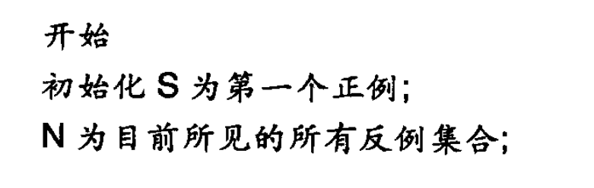
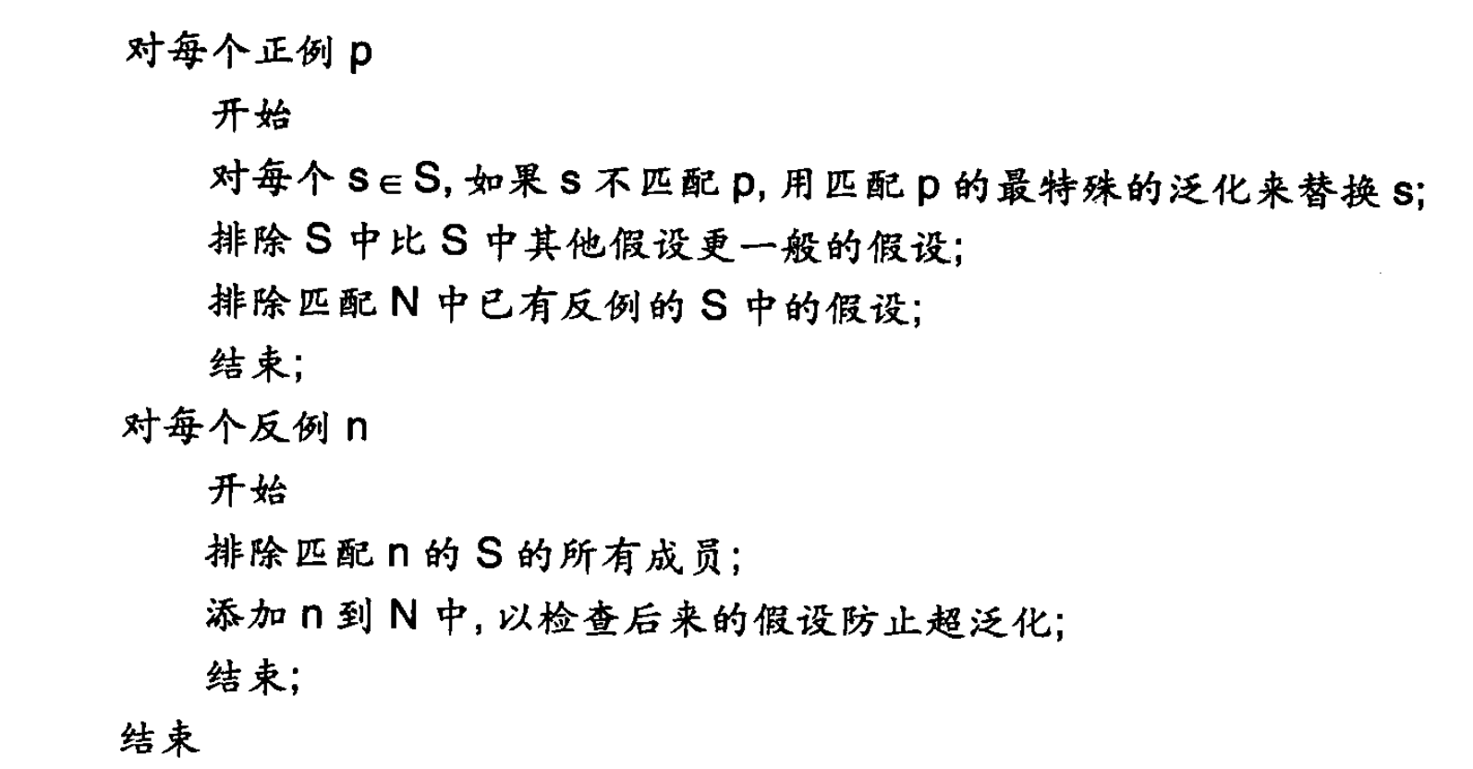
find-S algorithm： finds the most specific hypothesis that fits all the positive examples
starts with the most specific hypothesis and generalizes this hypothesis each time it fails to classify an observed positive training data. Hence, the Find-S algorithm moves from the most specific hypothesis to the most general hypothesis.

Slide 19
+
+
+
+
+
+
+
+
+
+
?
+
+
?
?
-
+
+
-
-
Concept induced from positive examples only
Concept induced from positive and negative examples
Figure 10.6 The role of negative examples in prevenring overgeneralization.

Slide 20
Ｓ：｛｝
positive:obj(small,red,ball)
positive:obj(small,white,ball)
S:{positive:obj(small,red,ball)}
S:{positive:obj(small,X,ball)}
positive:obj(large,blue,ball)
S:{obj(Y,X,ball)}
Figure 10.7 Specific to general search of the version space learning the concept ball

Slide 21
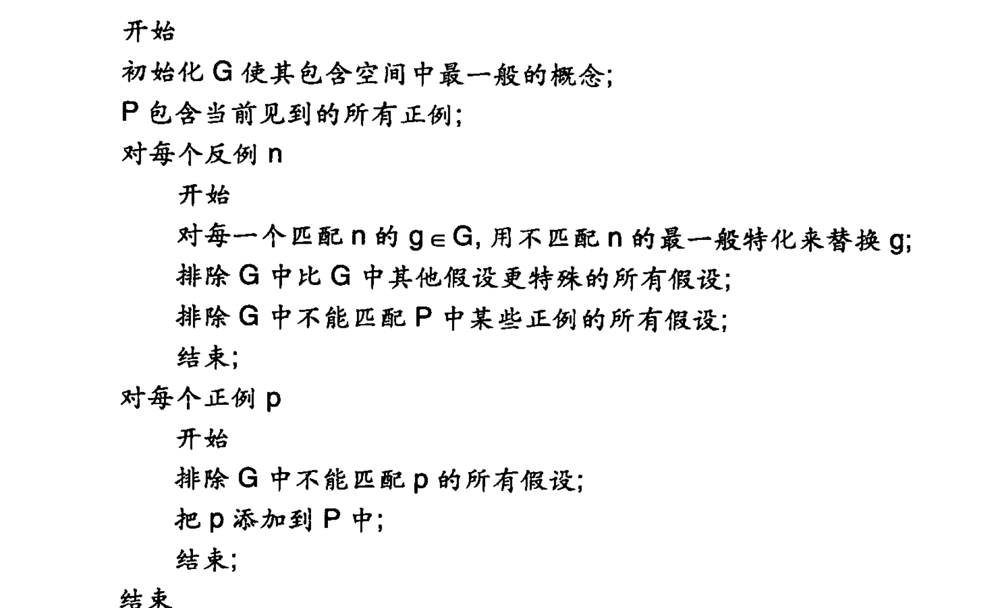

Slide 22
In this example ,the algorithm uses background knowledge that size may have values{large,small},color may have values{red,white,blue},and shape may have values {ball,brick,cube}.This knowledge is essential if the algorithm is to specialize concept by subsituing constants for variables.

Slide 23
G:{obj(X,Y,Z)}
Negative:obj(small,red,brick)
positive:obj(large,white,ball)
G:{obj(large,Y,Z),obj(X,white,Z);obj(X,blue,Z),obj(X,Y,ball),obj(X,Y,cube)}
G:{obj(large,Y,Z),
obj(X,white,Z),obj(X,Y,ball)}
Negative:obj(large,blue,cube)
G:{obj(large,white,Z),
obj(X,white,Z),obj(X,Y,ball)}
positive:obj(small,blue,ball)
Figure 10.8 general to specific search of the version space learning the concept ball
G:{obj(X,Y,ball)}

Slide 24
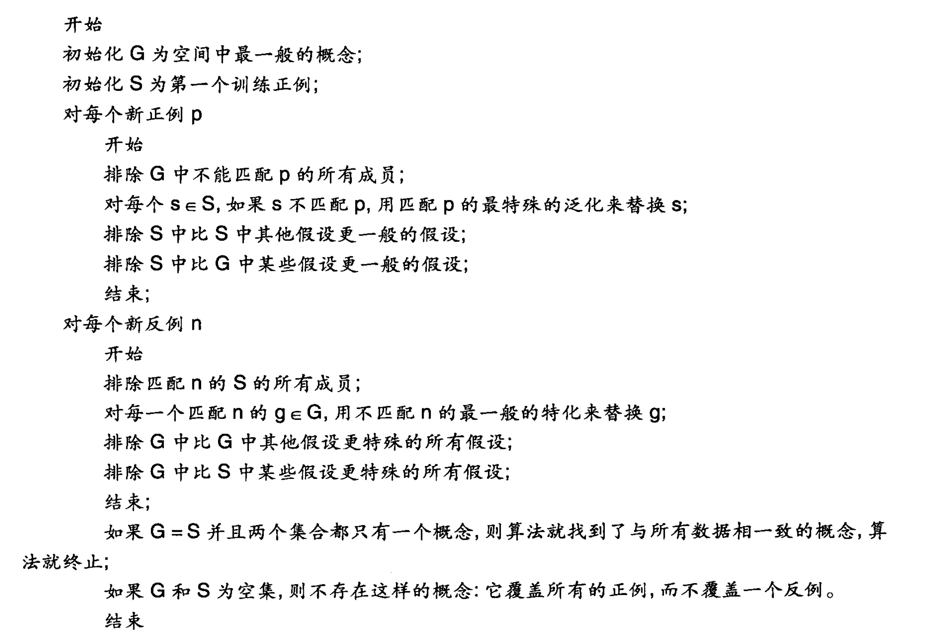
Positive examples are used here as the Find-S algorithm
If example is Negative example:Make generalize hypothesis more specific.

Slide 25
G:{obj(X,Y,Z)}
S:{}
positive:obj(small,red,ball)
Negative:obj(small,blue,ball)
G:{obj(X,Y,Z)}
S:{obj(small,red,ball)}
G:{obj(X,red,Z)}
S:{obj(small,red,ball)}
positive:obj(large,red,ball)
G:{obj(X,red,Z)}
S:{obj(X,red,ball)}
Negative:obj(large,red,cube)
G:{obj(X,red,ball)}
S:{obj(X,red,ball)}
Figure 10.9 The candidate elimination algorithm learning the concept red ball

Slide 26
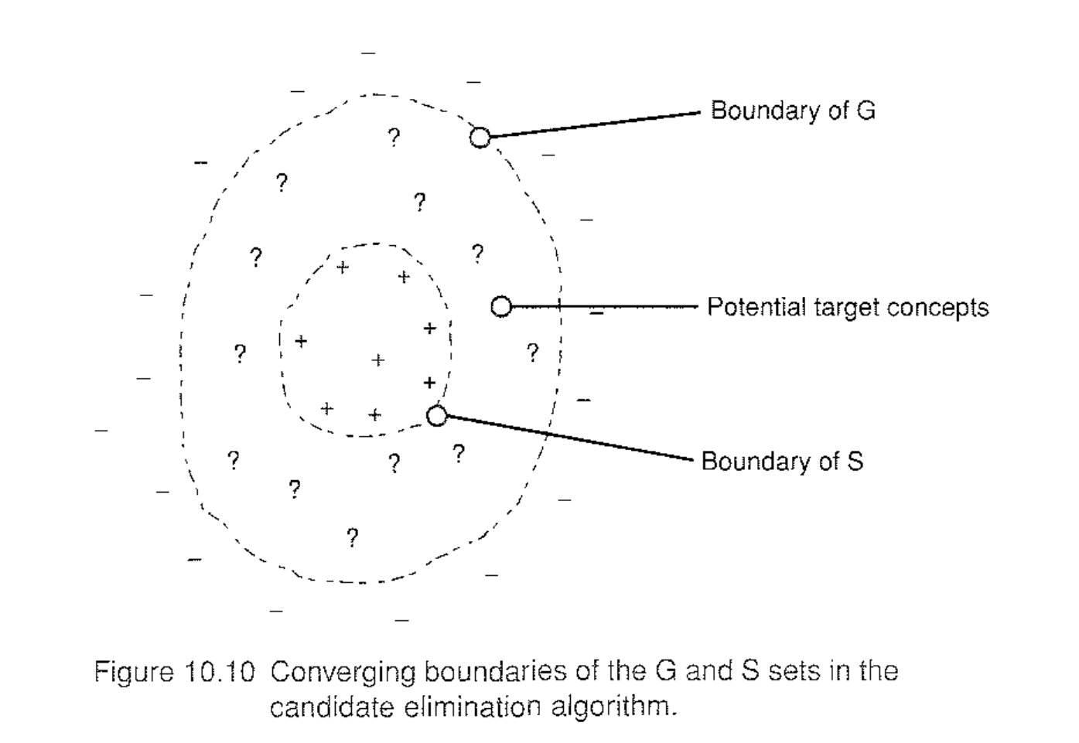

Slide 27
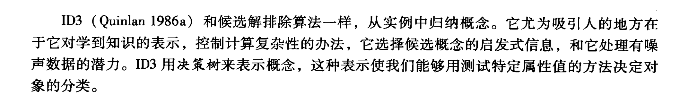
10.3 The ID3 Decision Tree Induction Algorithm
ID3,like candidate elimination ,induces concepts from examples.It is particularly interesting for its representation of learned knowledge,its approach to the management of complexity,its heuristic for selecting candidate concepts,and its potential for handing noisy data.ID3 represents concepts as decision trees, a representation that allows us to determine the classification of an object by testing its values for certain properties.

Slide 28
10.3 The ID3 Decision Tree Induction Algorithm
决策树是基于树状结构来进行决策的，一般地，一棵决策树包含一个根节点、若干个内部节点和若干个叶节点。
每个内部节点表示一个属性上的判断
每个分支代表一个判断结果的输出
每个叶节点代表一种分类结果。
根节点包含样本全集
决策树学习的目的是为了产生一棵泛化能力强，即处理未见示例能力强的决策树，其基本流程遵循简单且直观的“分而治之”（divide-and-conquer）策略。

Slide 29
估计个人信用风险问题：
NO. | 风险 | 信用历史 | 债务 | 抵押 | 收入
1 | 高 | 坏 | 高 | 无 | 0-15000美元
2 | 高 | 未知 | 高 | 无 | 15000-35000美元
3 | 中等 | 未知 | 低 | 无 | 15000-35000美元
4 | 高 | 未知 | 低 | 无 | 0-15000美元
5 | 低 | 未知 | 低 | 无 | 超过35000美元
6 | 低 | 未知 | 低 | 无 | 超过35000美元
7 | 高 | 坏 | 坏 | 无 | 0-15000美元
8 | 中等 | 坏 | 坏 | 充分 | 超过35000美元
9 | 低 | 好 | 好 | 无 | 超过35000美元
10 | 低 | 好 | 好 | 充分 | 超过35000美元
11 | 高 | 好 | 好 | 无 | 0-15000美元
12 | 中等 | 好 | 好 | 无 | 15000-35000美元
13 | 低 | 好 | 好 | 无 | 超过35000美元
14 | 高 | 坏 | 坏 | 无 | 15000-35000美元

Slide 30
信用历史？
未知
坏
好
债务？
抵押？
债务？
高
低
无
充分
高
低
高风险
抵押？
高风险
中等风险
抵押？
低风险
无
充分
无
充分
收入？
低风险
收入？
低风险
0—15000美元
15000—35000美元
0—15000美元
15000—35000美元
超过35000美元
超过35000美元
高风险
中等风险
低风险
高风险
中等风险
低风险
图10-13 信用风险评定的决策树

Slide 31
收入？
0—15000美元
超过35000美元
15000—35000美元
高风险
信用历史？
信用历史？
未知
坏
好
未知
坏
好
债务？
高风险
中等风险
低风险
高风险
中等风险
高
低
图10-14 信用风险评定的简化的决策树
高风险
中等风险

Slide 32
The ID3 algorithm assumes that this is the simplest decision tree that covers all the training examples.
This principle ,known as Occam’s Razor:
It is vain to do with more what can be done with less..Entities should not be multiplied beyond necessity.

Slide 33
10.3.1 Top-Down Decision Tree Induction
收入？
0—15000美元
15000—35000美元
超过35000美元
实例{1,4,7,11}
实例{2,3,12,14}
实例{5,6,8,9,10,13}
图10-15 一个部分建立的决策树

Slide 34
Function induce_tree(example_set,Properties)
Begin
If all entries in example _set are in the same class
Else if Properties is emplty
then return a leaf node labeled with that class
else if Properties is empty
then return leaf node labeled with disjunction of all classes in example_set
else begin
select a property,P,and make it the roof of the current tree.
delete p from Properties;
for each value,V,of P
begin
create a branch of the tree labeled with V;
let partition be elements of example_set with values V for property P;
call induce_tree (partition,Properties),attach result to branch v
end
end
end

Slide 35
收入？
0—15000美元
15000—35000美元
超过35000美元
高风险
信用历史？
实例{5,6,8,9,10,13}
未知
坏
好
实例{2,3}
实例{14}
实例{12}
图10-16另外 一个部分建立的决策树

Slide 36
10.3.2 Information Theoretic Test Selection
ID3算法的核心是根据信息增益来选择进行划分的特征，然后递归地构建决策树。
We may think of each property of an instance as contributing a certain amount of information to its classification.
Information theory provides a mathematical basis for measuring the information content of a message.
The number of possible messages is important.
The influence of the probability of each message on the amount of information is important.

Slide 37
The expected information content of a message M is given by:
The information in a message is measured in bits.For example,the information content of a message telling the outcome of the flip of an honest coin is:
I[Coin toss]=-p(heads)log2(p(heads))-p(tails)log2(p(tails))
=-1/2log2(1/2)-1/2log2(1/2)
=1 bit
If the coin has been rigged to come up heads 75 per cent of the time ,then the information concent of a message is:
I[Coin toss]=-3/4log2(3/4)-1/4log2(1/4)
= -3/4*(-0.145)-1/4*(-2)
=0.811 bits

Slide 38
Example label10-1:
P(risk is high)=6/14,p(risk is moderate)=3/14,p(risk is low)=5/14
It follows that the distribution described in Table10.1,D9.1
I[D9.1]=-6/14log2(6/14)-3/14log2(3/14)-5/14log2(5/14)
=-6/14*(-1.222)-3/14*(-2.222)-5/14*(-1.485)
=1.531bits
gain(P)=I[C]-E[p]
Example:we make income the property tested at the root of the tree,this partitions the table of example into the partitions C1={1,4,7,11},C2={2,3,12,14},and C3={5,6,8,9,10,13}The expected information needed to complete the tree is:

Slide 39
E[income]=4/14*I[C1]+4/14*I[C2]+6/14*I[C3]
=4/14*0.0+4/14*1.0+6/14*0.650
=0.564 bits
The information gain for the distribution of Table 10.1 is :
gain(income)=|[D9.1]-E[income]
=1.531-0.564
=0.967 bits
gain(credit history)=0.266
gain(debt)=0.063
gain(collateral)=0.206
Because income provides the greatest information gain,ID3 will select it as the root of the tree.

Slide 40
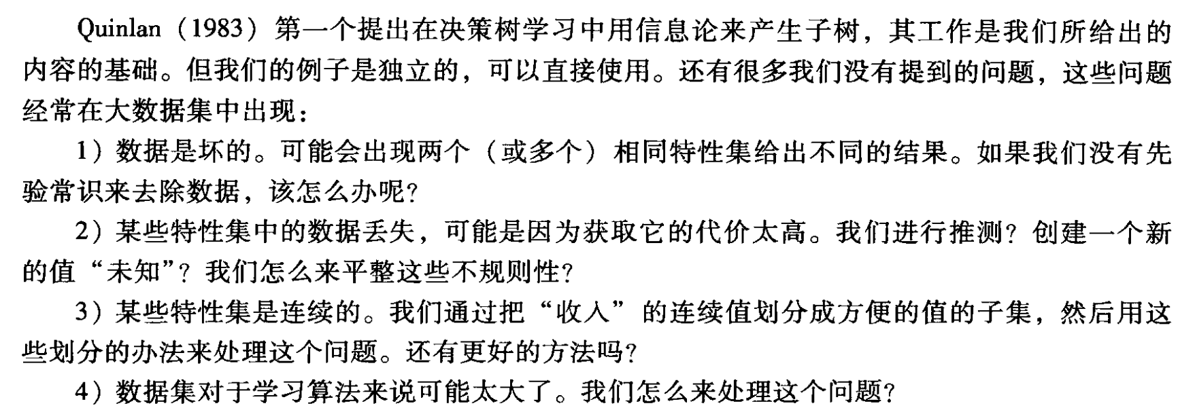
10.3.4 Decision Tree Data Issues:Bagging,Boosting

Slide 41
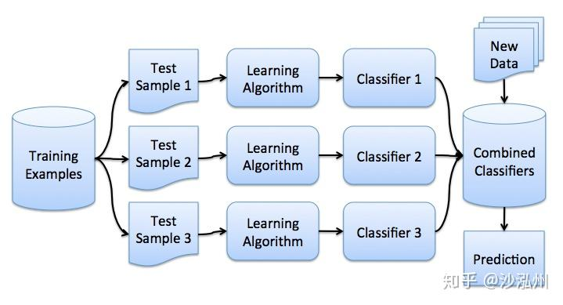
10.3.4 Decision Tree Data Issues:Bagging,Boosting
Bagging是Bootstrap aggregating的缩写
Bagging produces replicate training sets by sampling with replacement from the training instances.Boosting uses all instances at each replication,but maintains a weight for each instance in the training set.
In working with very large sets of data ,it is common to divide the data into subsets,build the decision tree on one subset,and then test its accuracy on other subsets.
Fibally ,it is straightforward to convert a decision tree into a conparable rule set.
Bagging通过从训练实例中进行有放回抽样，生成重复的训练集。Boosting在每次迭代中使用所有实例，但为训练集中的每个实例维护一个权重。
现实生活中的例子或类比：假设有一个决定要不要购买某种产品的问题，我们可以向一群朋友寻求建议。Bagging就像是我们从朋友中随机选择一部分人，每个人都独立地给出自己的建议，然后我们通过综合所有建议来做出决策。而Boosting则是我们向所有朋友提问，但根据他们以前的建议质量，我们会给予更多或更少的重视。

Slide 42
10.4 Inductive Bias and Learnability
10.4.1 Inductive bias
Inductive bias refers to any criteria a learner uses to constrain the concept space or to select concepts within that space.
Learning spaces tend to be large;without some way of pruning them,search-based learning would be a practical impossibility.
Another reason for the necessity of bias is the nature of inductive generalization itself.

Slide 43
The heuristic allows ID3 to search efficiently the space of decision trees.
Another form of inductive bias consists of syntactic constraints on the representation of learned concepts.
Example:{0,1,#} matching rules:
If the pattern has a 0 (1)in a certain position,then the target string must have a 0(1) in the corresponding position.
A # in a given position can match either a 1 or 0;
A number of representational biases:
Conjunctive biases,limitations on the number of disjuncts,feature vectors,decision trees.

Slide 44
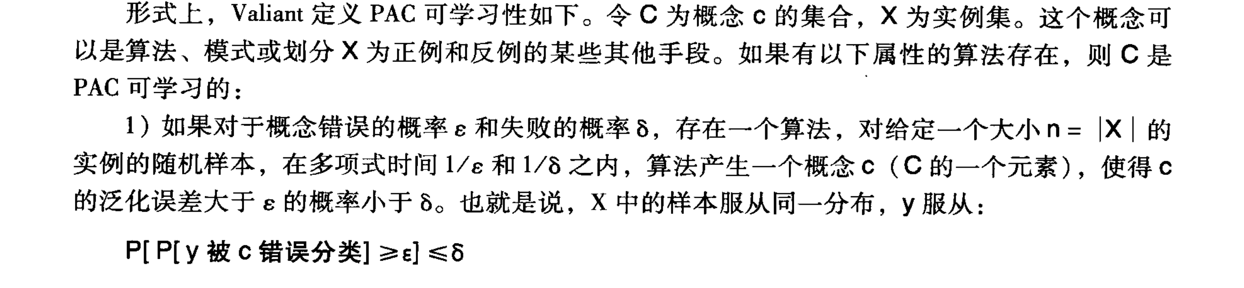
10.4.2 The Theory of Learnability
PAC learnability as follows. Let c be a set of concepts c and x a set of instances.C is PAC learnable if there exists an algorithm with the flolowing properties:
1.If for concept error α and failure probability β,there exsits an algorithm which,given a random sample of instances of size n=|X| polynomial in 1/ α,and 1/ β,the algorithm produces a concept c,an element of c,such that the probability that c has a generation error greater than α is less than β.That is ,for y drawn from the same distribution that the samples in X were drawn from: P[P[y is misclassified by c]>= α]<= β
2.The execution time for algorithm is polynomial in n,1/ α,and 1/ β.

Slide 45
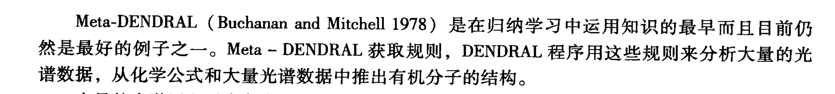
10.5 Knowledge and Leaning
10.5.1 Meta-DENDRAL
DENDRAL employs knowledge in the form of rules for interpreting mass spectrographic data.The premise of a DENDRAL rule is a graph of some portion of a molecular structure.The conclusion of the rule is that graph with the location of the clesvage indicated.
The half-order theory consists of rules:
Double and e bonds do not break.
Only fragments larger than two carbon atoms show up in the data.

Slide 46
It begins with a totally general description of a cleavage:X1*X2.This pattern means that a cleavage ,indicated by the asterisk,can occur between any two atoms.It specializes the pattern by:
Adding atoms:X1*X2->x3-X1*X2
Where the “-”operator indicates a chemical bond, or attributes of atoms:x1*x2->C*x2

Slide 47
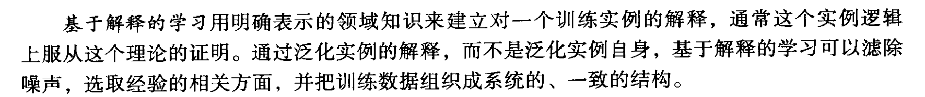
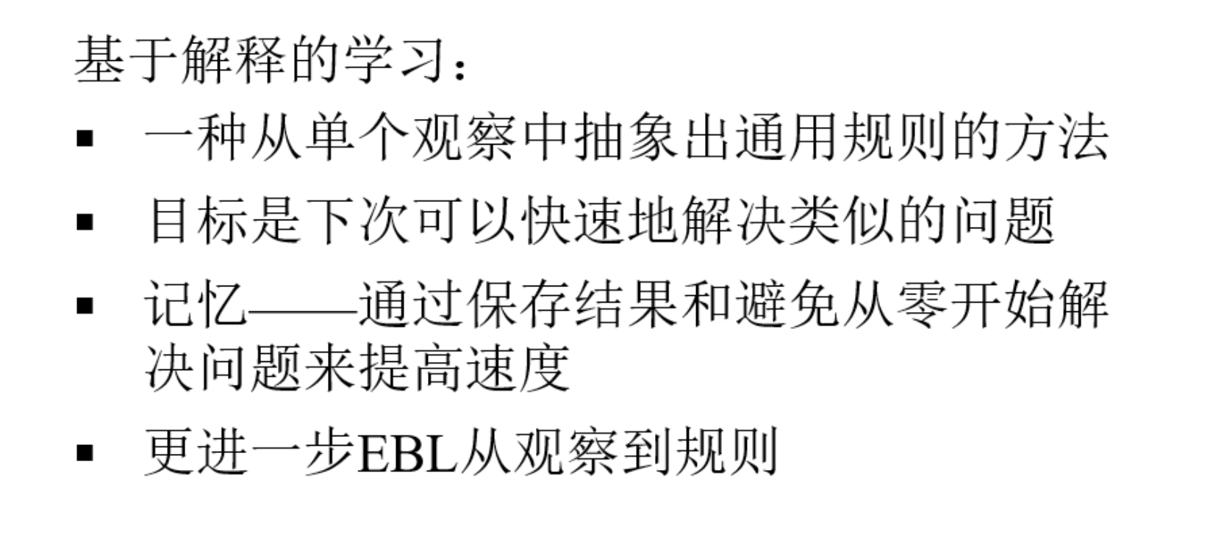
10.5.2 Explanation-Based Learning

Slide 48
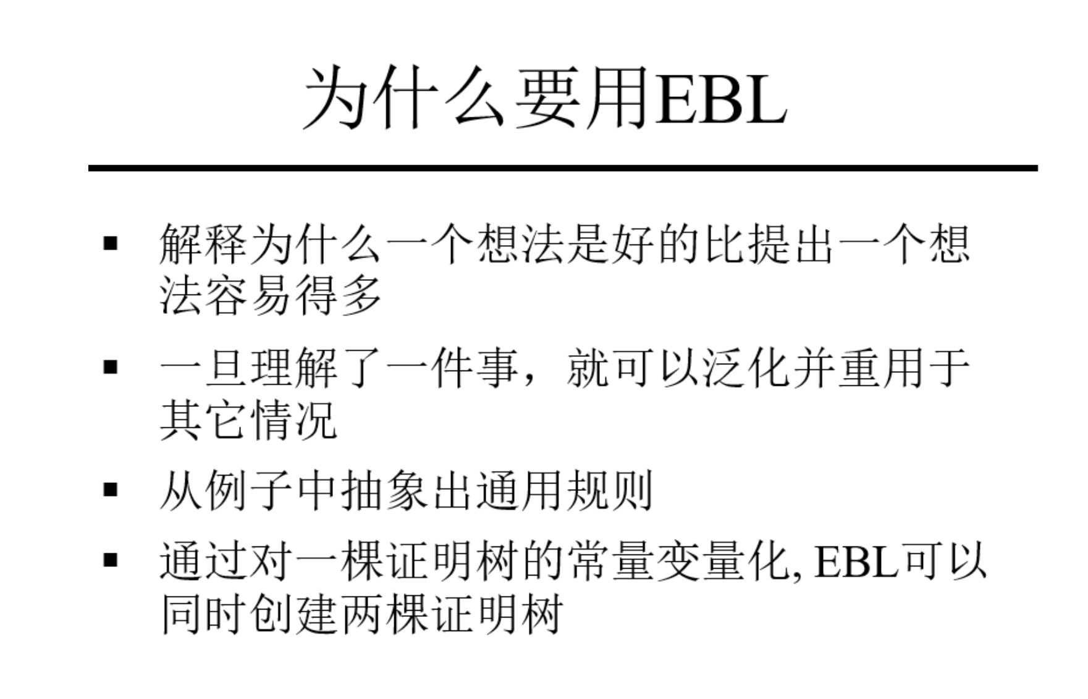
10.5.2 Explanation-Based Learning

Slide 49
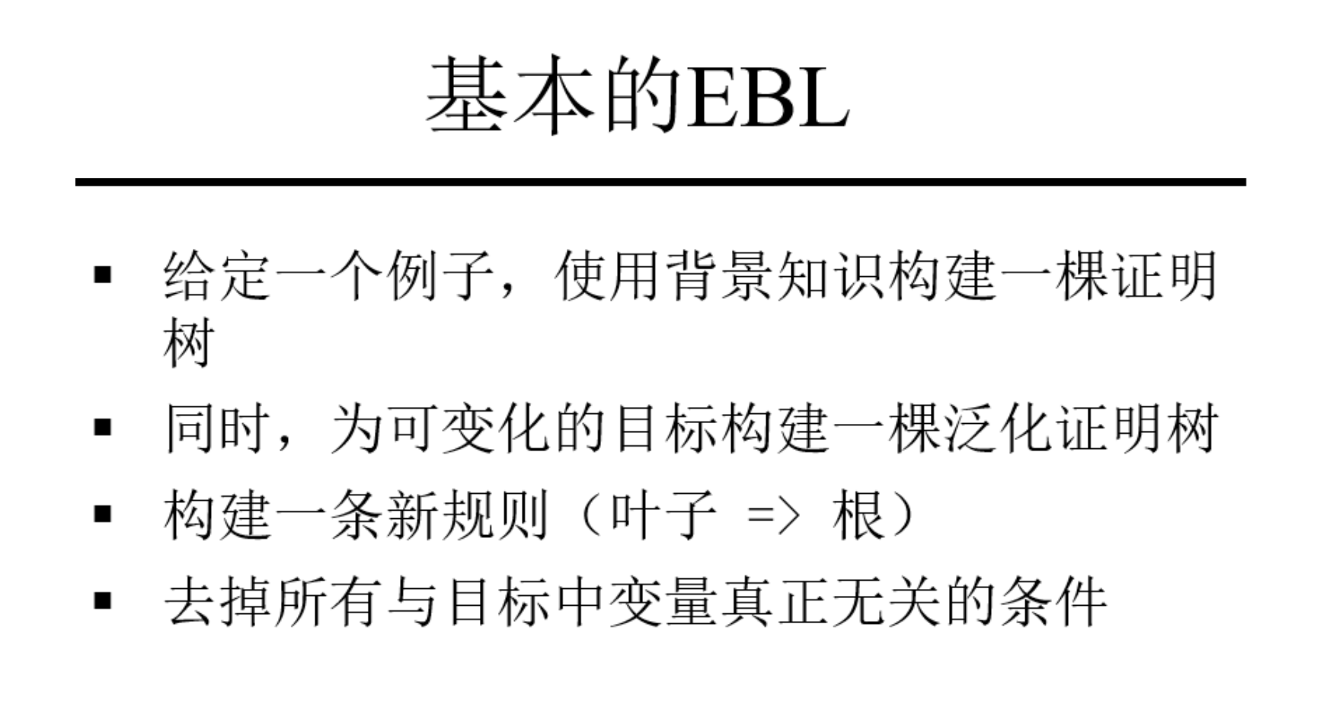
10.5.2 Explanation-Based Learning

Slide 50
10.5.2 Explanation-Based Learning
EBL begins with:
1.A target concept
2.A training example
3.A domain theory
4.Operationality criteria
Example: premise(X)->cup(x)
Assume a domain theory that includes the following rules about cups:
Liftable(X) ∧hold_liquid(x)->cup(x)
Part(Z,W) ∧concave(W) ∧points_up(W)->holds_liquid(Z)
Light(Y) ∧part(Y,handle)->liftable(Y)
Small(A)->light(A)
Made_of(A,feathers)->light(A)
目标概念
训练实例
领域理论知识
操作标准

Slide 51
The training example is an instance of the goal concept.That is,we are given:
Cup(obj1)
Small(obj1)
Part(obj1,handle)
Owns(bob,obj1)
Part(obj1,bottom)
Part(obj1,bowl)
Point_up(bowl)
Concave(bowl)
Color(obj1,red)
训练实例是目标概念的一个实例。

Slide 52
Proof that obj1 is a cup
Cup(obj1)
liftable(obj1)
Holds liquid(obj1)
liftable(obj1)
Part(obj1,handle)
Part(obj1,bowl)
concave(bowl)
points(bowl)
small(obj1)
Generalized proof that x is a cup
Cup(x)
liftable(X)
Holds liquid(X)
light(X)
Part(X,handle)
Part(X,W)
concave(w)
Points_up(w)
small(X)
图10-17 物体X是一个杯子的特化和泛化证明

Slide 53
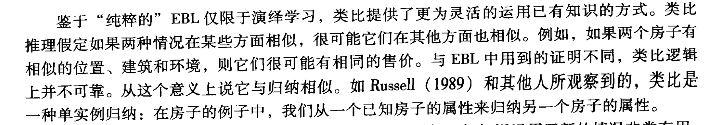
10.5.4 EBL and Knowledge-Level Learning

Slide 54
10.5.4 EBL and Knowledge-Level Learning
A typical framework consists of the following stages:
1.Retrieval
2.Elaboration
3.Mapping and inference
4.Justification
5.Learning

Slide 55
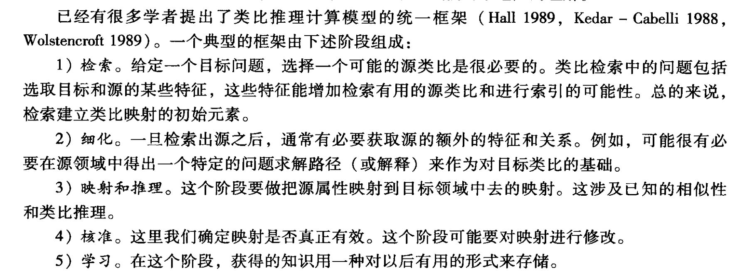
10.5.4 EBL and Knowledge-Level Learning

Slide 56
hotter-than
more-massive
物物体：
物关系：
more-massive
cause
二阶关系：
cause
类比映射：
sun
attract
earth
nucleus
attract
electron
cause
cause
revolves-around
revolves-around
图10-19 一个类比映射

Slide 57
The source domain includes the predicates:
Yellow(sun)
Blue(earth)
Hotter-than(sun,earth)
Causes(more-massive(sun,earth),attract(sun,earth))
Causes(attract(sun,earth),revolves-around(earth,sun))
The target domain that the analogy is intended to explain includes:
More-massive(nucleus,electron)
Revolves-around(electron,nucleus)
Structure mapping is constrained by the following rules:
1.Properties are dropped from the source.
2.Relation map unchanged from the source to the target

Slide 58
3.In constructing the mapping,higher-order relations are preferred as a focus of the mapping.
These constraints lead to the mapping:
Sun->nucleus
Earth->electron
Extending the mapping leads to the inference:
Causes(moremassive(nucleus,electron),attract(nucleus,electron))
Causes(attract(nucleus,electron),revolves-around(nucleus,electron))

Slide 59

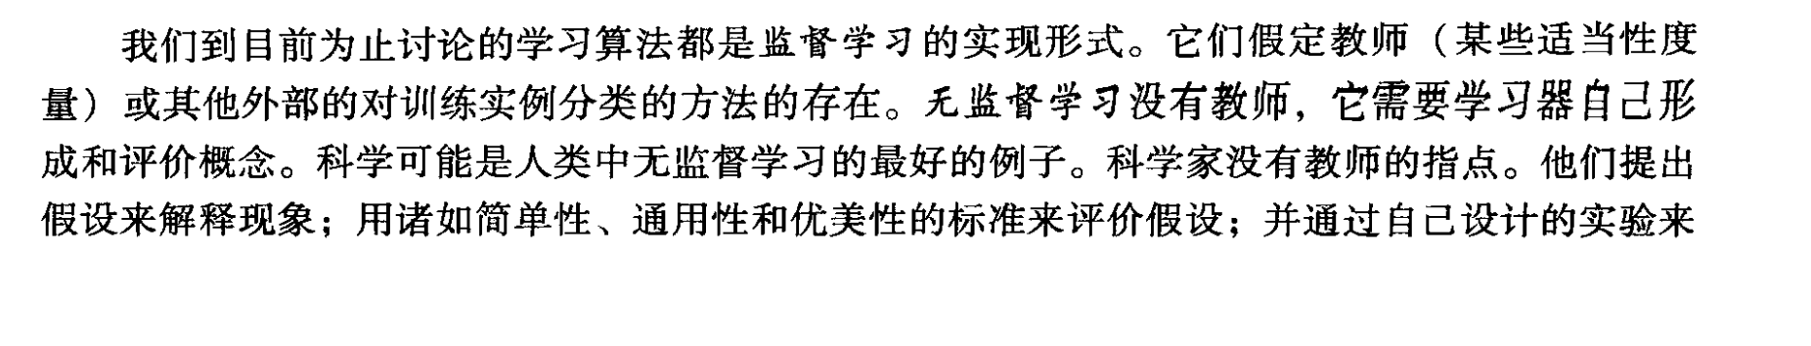
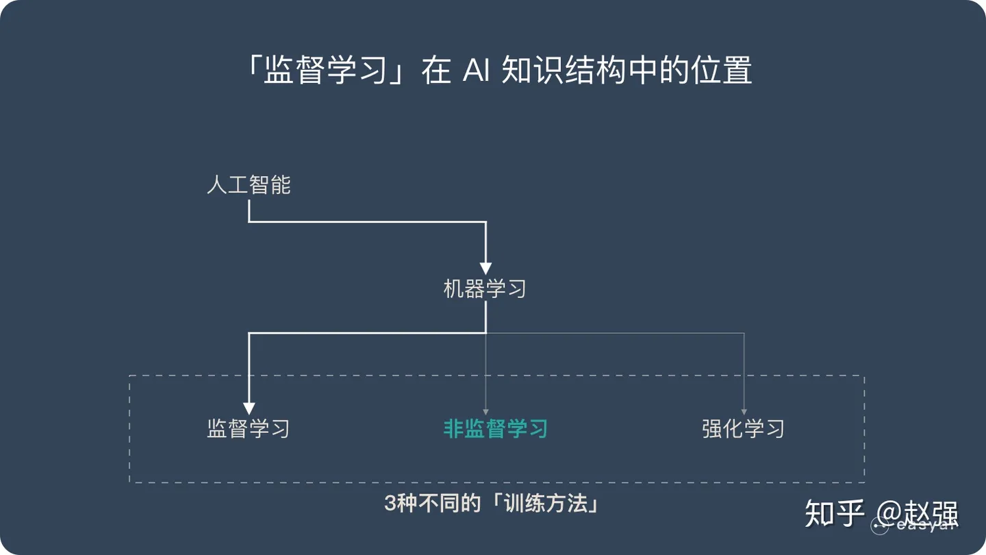
10.6 Unsupervised Learning

Slide 60
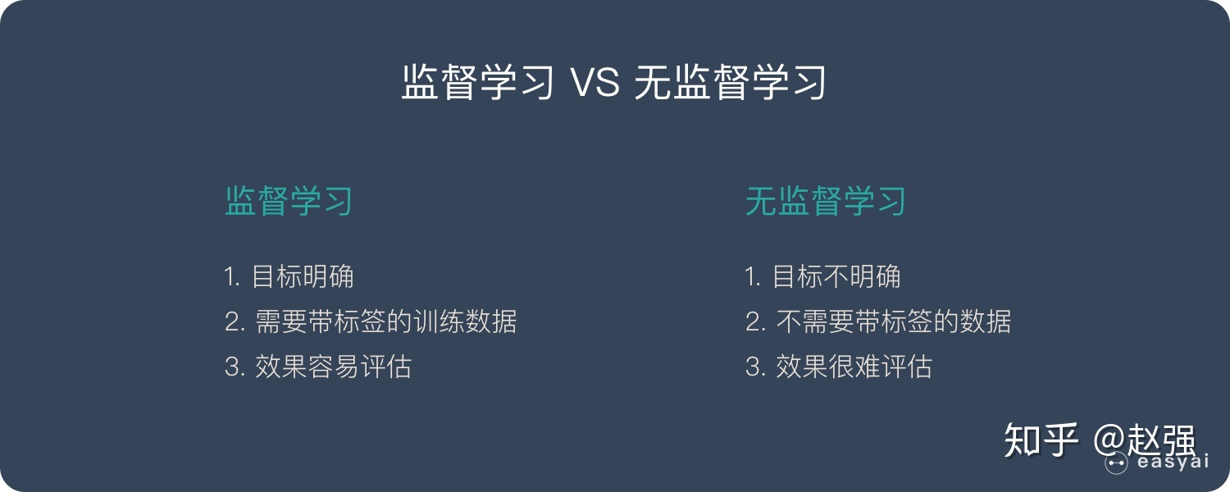
10.6 Unsupervised Learning

Slide 61
10.6.2 Conceptual Clustering
The clustering problem begins with a collection of unclassified objects and a means for measuring the similarity of object.The goal is to organize the object into classes that meet some standard of quality.
Numeric methods rely upon the representation of objects as a collection of features,each of which may have some numeric value .

Slide 62
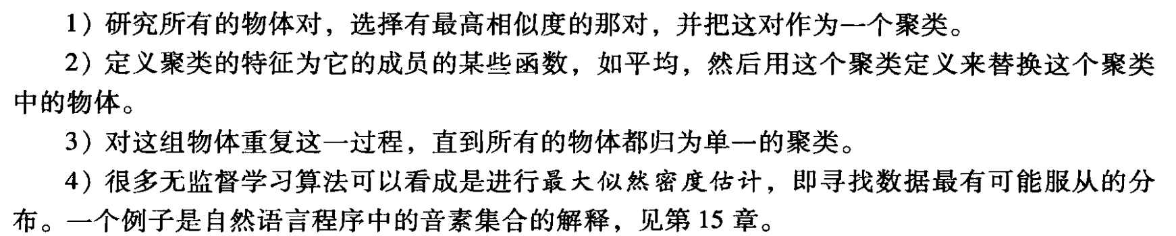
Applomerative clustering strategy:
1.Examining all pairs of objects,selecting the pair with the highest degree of similarity,and making that pair a cluster.
2.Defining the features of the cluster as some function,such as average,of the features of the component member and then replacing the component objects with this cluster definition.
3.Repeating this process on the collection of objects until all objects hava been reduced to a single cluster.
4.Many unsupervised learning algorithms can be viewed as performing maximum liklihood density estimations,which means finding a distribution from which the data is most likely to have been drawn

Slide 63
10.7 Reinforcement Learning
10.7.1 The Components of Reinforcement Learning
Reinforcement learning is not defined by particular learning methods ,but by actions within and responses from an environment. Any learning method creating this interaction is an acceptable reinforcement learning method.
Introduce some terminology for reinforcement learning: t is a discrete time step in the problem solving process.
St is the problem state at t,dependent on st-1 and at-1
at is the action at t ,dependent on st.
rt is the reward at t,dependent on St-1 and at-1

Slide 64
The policy defines the learning agent’s choice and method of action at any given time.
The reward function rt defines the state /goal relationshios of the problem at time t.
The value function V is a property of each state of the environment indicating the reward the system can expect for actions continuing on from that state.
A final-and optional-element for reinforcement learning is the model of the environment.

Slide 65
10.7.2 An Example:Tic-Tac-Toe Revisited
我的移动：
… …
对手的移动：
X
X
O
我的移动：
X
对手的移动：
X
O
X
X
O
O
我的移动：
X
X
X
O
对手的移动：
O
(WIN!)
图10-23 九宫游戏的一个移动序列
… …

Slide 66
We usually do this by moving the previous state some fraction of the value of difference between itself and the newer state we have selected.This fractional measure,called the step-size parameter,is reflected by the multiplier c in the eauation:
V(sn)=v(sn)+c(v(sn+1)-v(sn))

Slide 67
10.7.3 Inference Algorithm and Applications for Reinforcement Learning
The dynsmic programing approach is built on the fact that for any policy π and any state s the following recursive consistency equation holds:
Q learning is a variant of the temporal difference approach.For all states and actions:
Q:(state x action)->value
For one step Q –learning:

Slide 68
S
max
a
r
S’
a)对V*的回溯图
S，a
r
S’
max
a’
b)对Q*的回溯图
图10-24 对a) V*的回溯图b)对Q*的回溯图

